Slide 1


Few Prerequisites
Bitwise & Unsafe Rust

Slide 2
Few Prerequisites
Following are the prerequisites need to be covered before jumping into sea of embedded programming.
Binary Numbering System
Bitwise operators
Unsafe Rust
Raw Pointers
Mutable Static variables

Slide 3
Binary Number System

Slide 4
Binary Number System
Keep the points in mind in sequence.
Binary numbers are made up of only 1’s and 0’s. They don’t contain any other number we usually see in decimals (i.e. 2,3,4,...,9). Here are few examples.
Decimal | 0 | 1 | 2 | 4 | 13 | 21 | 27 | 45
Binary | 0 | 1 | 10 | 100 | 1101 | 10101 | 11011 | 101101

Slide 5
Binary Number System
2. Binary numbers have base of 2 in contrast our decimal numbers
which have base 10. What base tells us? It tells how many combination
can a number give us.
Decimal |  | Binary
0000 | Starts at 0 | 0000 | Starts at 0
0009 | Goes upto 9 | 0001 | Goes upto 1
0010 | Reset the digit and increment the next digit. | 0010 | Reset the current digit and increment the next
0019 | Again goes upto 9 | 0011 | What happens next?
0099 | What happens with 99, now 2 digits are at optimum | 0100 | Initial 2 digits got reset and next digit will be incremented
0100 | Both will got reset and next digit will be incremented.

Slide 6
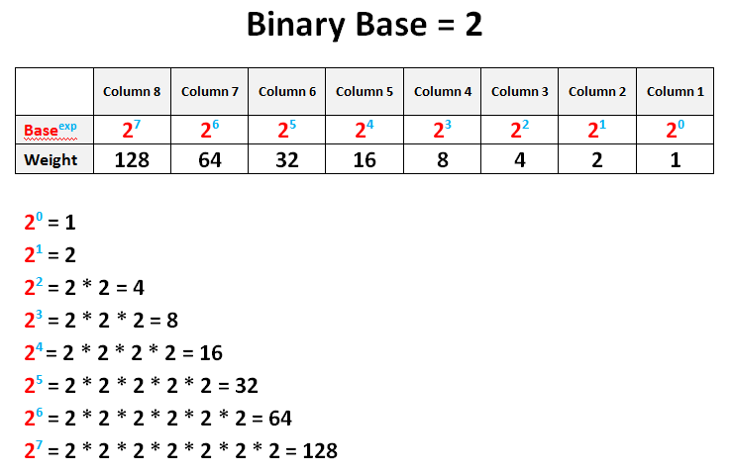
Binary Number System
Now, let’s see how to read the binary numbers and also how to convert decimal numbers into binary numbers.
Significance of each bit.

Slide 7
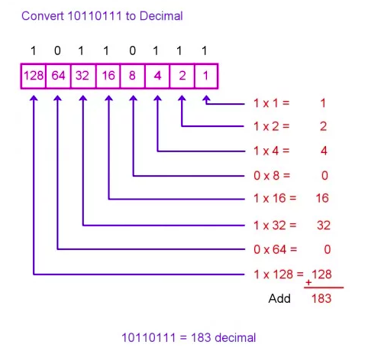
Binary Number System
Now we actually going to convert a decimal number into binary.
Keep the points we learnt so far while converting the number.
Notes:
This mechanism tells us what powers of two is present in any given number.
Learning Resources :
https://www.mathsisfun.com/binary-number-system.html
https://owlcation.com/stem/How-to-Convert-Decimal-to-Binary-and-Binary-to-Decimal

Slide 8
Bitwise Operators

Slide 9
Rust Bitwise Operator
Wondering! What these are?
Now you are familiar with binary numbers. Next we will see concept of Bitwise operators that based on the binary numbers.
There are variety of operators in programming languages (i.e. arithmetic, relational, logical and assignment operators). Bitwise operator is one of them.
Bitwise operators: & , | , ^ , ! , << , >>
Assume values: A = 2 (b10) , B = 3 (b11)
Notes:
Most you might wonder what kind of operator these are.
Arithmetic, unary, assignment, logical, relational.

Slide 10
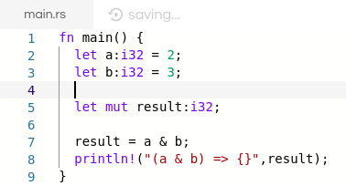
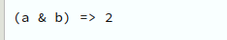
Bitwise AND ( & )
It performs a Boolean AND operation on each bit of its integer arguments.
Example:
A & B => 2, How come this result evaluated ?
Result :
1 0 & 1 1
1 0

Slide 11
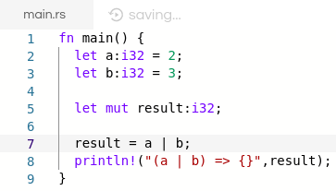
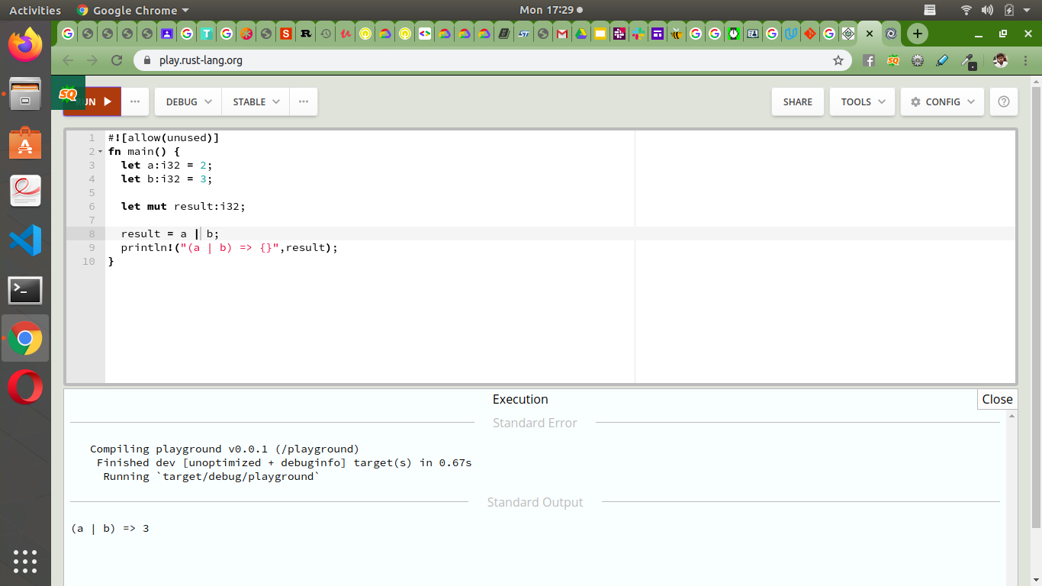
Bitwise OR ( | )
It performs a Boolean OR operation on each bit of its integer arguments.
Example:
A | B => 3, How come this result evaluated ?
Result :
1 0 | 1 1
1 1

Slide 12


Bitwise XOR ( ^ )
It performs a Boolean exclusive OR operation on each bit of its integer arguments.
Example:
A ^ B => 1, How come this result evaluated ?
Result :
1 0 ^ 1 1
0 1

Slide 13
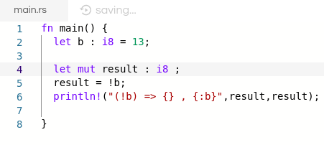
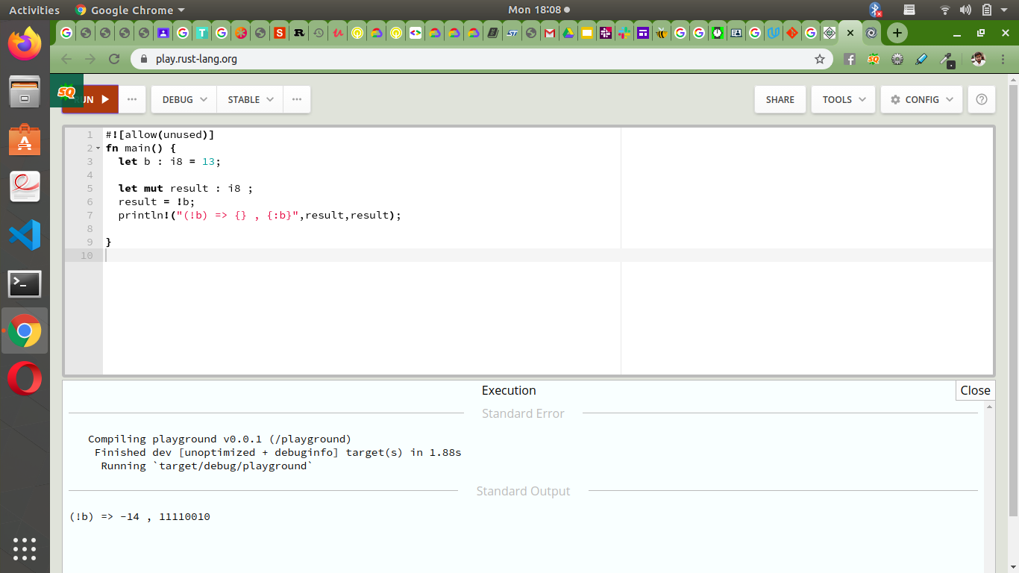
Bitwise NOT ( ! )
It is a unary operator and operates by reversing all the bits in the operand.
Example:
!B => -14, How come this result evaluated ?
Result :
! 0 0 0 0 1 1 0 1
1 1 1 1 0 0 1 0 ( - 1 4 )

Slide 14


Bitwise left shift ( << )
It moves all the bits in its first operand to the left by the number of places specified in the second operand.
Example:
A << B = 16, How come this result evaluated ?
Result :
( 2 ) 0 0 0 0 0 0 1 0 << 3
(16) 0 0 0 1 0 0 0 0

Slide 15

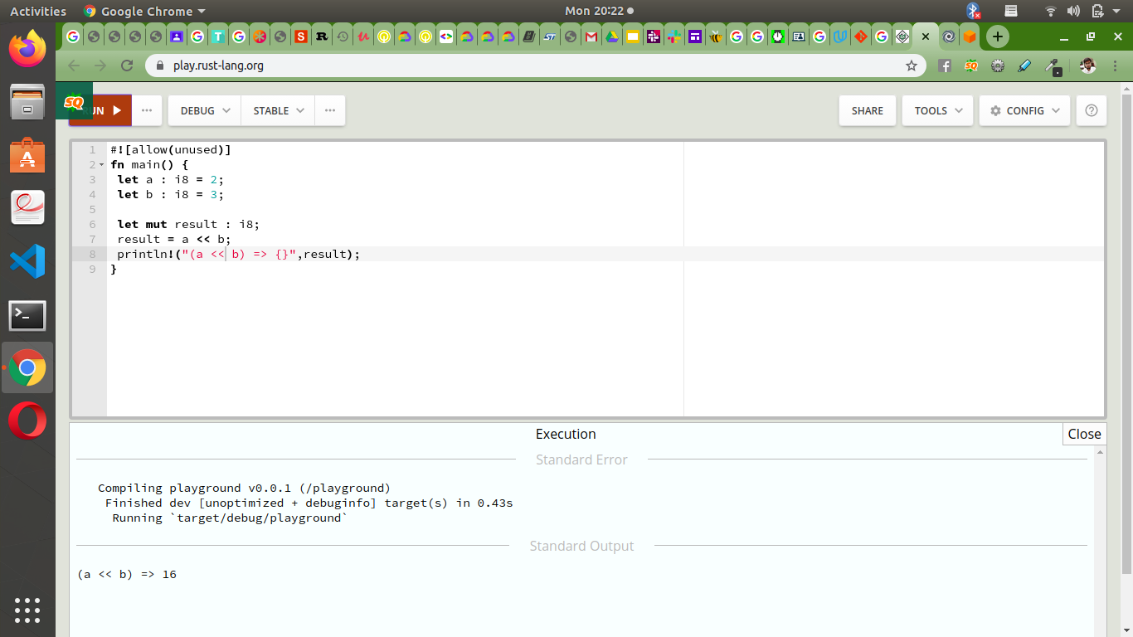
Bitwise right shift ( >> )
Binary Right Shift Operator. The left operand’s value is moved right by the number of bits specified by the right operand.
Example:
A >> B = 0, How come this result evaluated ?
Result :
( 2 ) 0 0 0 0 0 0 1 0 >> 3
( 0 ) 0 0 0 0 0 0 0 0

Slide 16
Unsafe Rust

Slide 17

Unsafe Rust
What is that?
Hidden language inside Rust
Gives us extra superpowers
Why is it?
It let us do the operations which compiler restricts us from
Without unsafe Rust we can’t do operations on hardware level
Unsafe Superpowers:
Dereference a raw pointer
Call an unsafe function or method
Access or modify a mutable static variable
Implement an unsafe trait
Notes:
Ownership and dangling reference.
Rust compiler rejects some valid programs rather than accepting some invalid program. In such cases you can tell rust compiler, trust me this code is fine.
Another important reason is Under lying hardware is unsafe. And Rust don’t let you that unsafe task here is the time when unsafe rust come into play. Being a system leel programming language.

Slide 18
Unsafe Rust
While using unsafe Rust keep few things in mind:
Unsafe rust doesn’t disable borrow checker or any other safety feature.
It gives you only access to these four features and compiler don’t check for memory safety in them.
Inside unsafe block the code doesn’t need to be necessarily dangerous.
While writing code keep the unsafe block smaller.
For the isolation of unsafe code, it’s better to enclose unsafe code with in a safe abstraction. Wrapper!
When using unsafe rust you as programmer have to ensure that you are accessing memory in a valid way.

Slide 19

Unsafe Rust
A simple unsafe code block:

Slide 20
Raw Pointers

Slide 21
Raw pointer
Unsafe Rust has two new types called raw pointers that are similar to references. They can be immutable or mutable and can be written as:
*const T (Immutable)
*mut T (Mutable)
Note: Asterisk “ * ” is not a dereferencing operator, it’s part of type name.
Let’s see how to create an immutable and mutable raw pointer from reference.
Is something wrong! We didn’t include unsafe keyword here? Well, its okay to create raw pointers outside unsafe but it’s must to include while dereferencing them.
Notes:
We made the above raw pointers from references guaranteed to be valid.

Slide 22
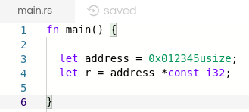
Raw pointer
Now, let’s create a raw pointer whose validity can’t be guaranteed.
Above approach to access memory is not recommended, however, you might see or write this kind of code.
Notes:
As we don’t know what actually resides on this address, either any value or null.

Slide 23
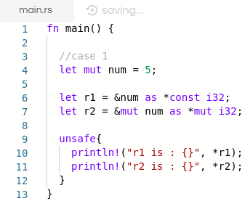
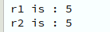
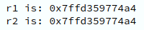
Dereference a raw pointer
At the end we will access these raw pointers or dereference them.
Case 1:
Creating a raw pointer and dereference it
from a valid reference is completely okay.
Upon running this code we’ll get the result:
What if we print values of r1 and r2.

Slide 24

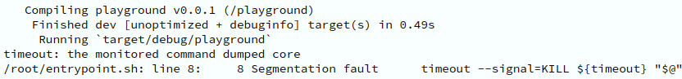
Dereference a raw pointer
Case 2:
But when creating a reference from
arbitrary location of memory and trying
dereference it. It could be problematic.
There might be data at that location or
might be not.
We’ll get the following result
upon executing this code.
Notes:
Segmentation Fault : https://kb.iu.edu/d/aqsj

Slide 25
Raw pointer
How raw pointers different from references!
Are allowed to ignore the borrowing rules by having both immutable and mutable pointers or multiple mutable pointers to the same location
Aren’t guaranteed to point to valid memory
Are allowed to be null
Don’t implement any automatic cleanup

Slide 26
Static Variables

Slide 27
Static variables
Global variables in Rust are called static variables
Static variables are similar to Constants
Naming style of static variables is in SCREAMING_SNAKE_CASE
Type annotation for static variables is must (like constants).
Rust allows access read-only static variables (immutable static variables ), however doesn’t allow access to immutable static variables.
Static variables always have fixed address in memory.
Notes:
Programming Case Type : https://www.chaseadams.io/most-common-programming-case-types/

Slide 28
Summary
Notes:
For feedback : https://docs.google.com/forms/d/e/1FAIpQLScIpqkmAtLNb2eSnOUxeTzFyCph8f-dPRy_Mp9VGIBn3FCTng/viewform?usp=sf_link
For contact : 0333-3459139

